Slide 1
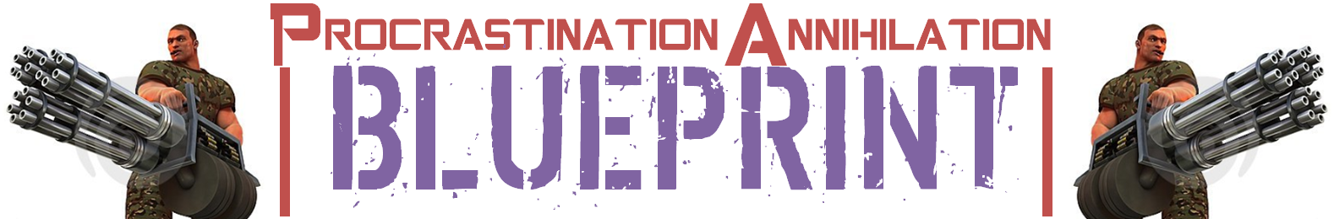
Procrastination
Procrastination
Procrastination
Procrastination
Procrastination
Procrastination
Procrastination
Procrastination
Procrastination
Procrastination
Procrastination
Procrastination
Procrastination
Procrastination
Procrastination

Slide 2
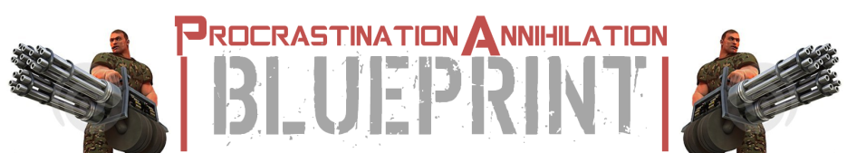
THE DOERS MIND PATTERN BLUEPRINT |\-| INNER GAME
How to Completely Annihilate Procrastination Habits
B O N U S 1
WINNING THE GAME OF BUSINESS
HOW TO MASTER CONTROL OVER YOUR EMOTIONS
OVERIDE FEAR & ACHIEVE ANYTHING
‘There’s nothing good or bad, but thinking makes it so’
Hamlet by William Shakespeare!
bonus:
ALIGN it
How To Master & Control Your Emotions

Slide 3
THE DOERS MIND PATTERN BLUEPRINT |\-| INNER GAME
How to Completely Annihilate Procrastination Habits
B O N U S 1
WINNING THE GAME OF BUSINESS
HOW TO MASTER CONTROL OVER YOUR EMOTIONS
OVERIDE FEAR & ACHIEVE ANYTHING
The truth is what’s creating your emotions is you, it’s how you THINK about the environment that creates the emotions
bonus:
ALIGN it
How To Master & Control Your Emotions

Slide 4
THE DOERS MIND PATTERN BLUEPRINT |\-| INNER GAME
How to Completely Annihilate Procrastination Habits
B O N U S 1
WINNING THE GAME OF BUSINESS
HOW TO MASTER CONTROL OVER YOUR EMOTIONS
OVERIDE FEAR & ACHIEVE ANYTHING
here’s what really happens when you are consciously aware of what’s really going on
What you have is an external circumstance,
You don’t have an emotion,
You have thought (about the circumstance).
Which creates an INTERPRETATION filter.
Which creates emotions,
It was your interpretation of the information that made you feel that way.
You took action based on that emotion and you created some sort of results
bonus:
ALIGN it
How To Master & Control Your Emotions

Slide 5
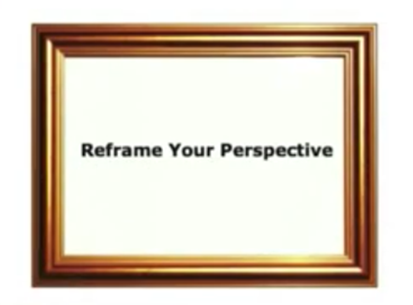

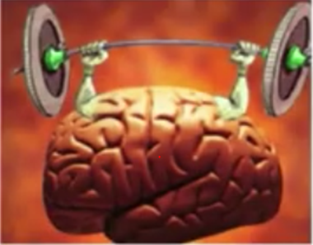
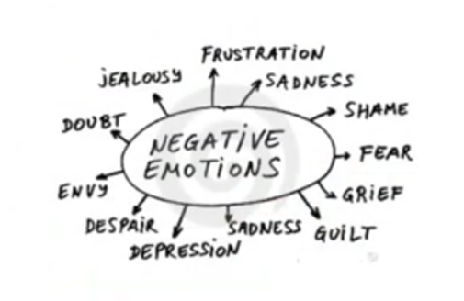
THE DOERS MIND PATTERN BLUEPRINT |\-| INNER GAME
How to Completely Annihilate Procrastination Habits
B O N U S 1
WINNING THE GAME OF BUSINESS
HOW TO MASTER CONTROL OVER YOUR EMOTIONS
OVERIDE FEAR & ACHIEVE ANYTHING
LAYER OF iNtERPRETATION
HOW TO MASTER CONTROL OVER YOUR EMOTIONS
1. RECOGNIZE (Negative thought, belief, emotion or behavioural pattern)
2. REFRAME (YOUR BELIEFS AND PERCEPTIONS
3. RELEASE (negative emotions or thoughts)
4. REtrain
(your brain)
Be Mindful of how you FEEL understand (FEELINGS are nothing more than SIGNALS)
bonus:
ALIGN it
How To Master & Control Your Emotions

Slide 6
THE DOERS MIND PATTERN BLUEPRINT |\-| INNER GAME
How to Completely Annihilate Procrastination Habits
B O N U S 1
WINNING THE GAME OF BUSINESS
HOW TO MASTER CONTROL OVER YOUR EMOTIONS
OVERIDE FEAR & ACHIEVE ANYTHING
Your Thoughts About Things
Create
Emotions
Create
Actions
bonus:
ALIGN it
How To Master & Control Your Emotions

Slide 7
THE DOERS MIND PATTERN BLUEPRINT |\-| INNER GAME
How to Completely Annihilate Procrastination Habits
B O N U S 1
WINNING THE GAME OF BUSINESS
HOW TO MASTER CONTROL OVER YOUR EMOTIONS
OVERIDE FEAR & ACHIEVE ANYTHING
Instead of negative thoughts, have positive thoughts
about the same situation:
bonus:
ALIGN it
How To Master & Control Your Emotions

Slide 8
THE DOERS MIND PATTERN BLUEPRINT |\-| INNER GAME
How to Completely Annihilate Procrastination Habits
B O N U S 1
WINNING THE GAME OF BUSINESS
HOW TO MASTER CONTROL OVER YOUR EMOTIONS
OVERIDE FEAR & ACHIEVE ANYTHING
‘If you are distressed by anything external. The pain is not due to the event itself but due to your own estimate of it and this you have the power to revoke at any moment’ Marcus Cerillius
bonus:
ALIGN it
How To Master & Control Your Emotions

Slide 9
THE DOERS MIND PATTERN BLUEPRINT |\-| INNER GAME
How to Completely Annihilate Procrastination Habits
B O N U S 1
WINNING THE GAME OF BUSINESS
HOW TO MASTER CONTROL OVER YOUR EMOTIONS
OVERIDE FEAR & ACHIEVE ANYTHING
‘My thoughts dictate how this goes, maybe I should go contrary to what I perceive to be natural. I want an Epic life. I don’t want to live like everybody else.’ YOU
bonus:
ALIGN it
How To Master & Control Your Emotions

Slide 10
THE DOERS MIND PATTERN BLUEPRINT |\-| INNER GAME
How to Completely Annihilate Procrastination Habits
B O N U S 1
WINNING THE GAME OF BUSINESS
HOW TO MASTER CONTROL OVER YOUR EMOTIONS
OVERIDE FEAR & ACHIEVE ANYTHING
Take 100% reasonability for positive emotions and negative ones. It’s not circumstances causing you to feel a certain way, it’s not somebody else’s actions it’’s you
bonus:
ALIGN it
How To Master & Control Your Emotions

Slide 11
THE DOERS MIND PATTERN BLUEPRINT |\-| INNER GAME
How to Completely Annihilate Procrastination Habits
B O N U S 1
WINNING THE GAME OF BUSINESS
HOW TO MASTER CONTROL OVER YOUR EMOTIONS
OVERIDE FEAR & ACHIEVE ANYTHING
How to prime your brain to accept something new, That ordinarily it will reject.
1. Start with Clear picture of what your goal is
2. Every Day for 5min look at a picture and imagine emotionally act and pretend that Its real.
bonus:
ALIGN it
OVERIDE FEAR & ACHIEVE ANYTHING!

Slide 12
THE DOERS MIND PATTERN BLUEPRINT |\-| INNER GAME
How to Completely Annihilate Procrastination Habits
The EPIC Secret
The Duty Method
Accelerated Fear Formula
Emotion Driver Shortcut
Mind Control Science
The Value System
The Paradigm Effect
M O D U L E 2
Inner and Outer game shifts
INNER GAME CHANGE
OUTER GAME CHANGE
BELIEVE that it’s possible to achieve something e.g. financial independence
JOIN others who have achieved financial independence and others who are dedicated to achieving this
This COMBINATION will likely lead to actually achieving financial independence
Mind Control Science

Slide 13
THE DOERS MIND PATTERN BLUEPRINT |\-| INNER GAME
How to Completely Annihilate Procrastination Habits
B O N U S 1
WINNING THE GAME OF BUSINESS
HOW TO MASTER CONTROL OVER YOUR EMOTIONS
OVERIDE FEAR & ACHIEVE ANYTHING
#1) What are you not doing, that you know you should, but you won’t because of fear?
#2) If you actually did what you are planning, what is the absolute worst thing that you dread that could happen?
3) If in the unlikely event what you plan isn’t successful, and the thing that you dread actually happens, what could you do to rectify it?
#4) What are the benefits/results that you ARE actually believing will happen, which are therefore more likely to occur than what you actually dread since it’s what you are planning for?
#5) What will, not taking action cost?
bonus:
ALIGN it
OVERIDE FEAR & ACHIEVE ANYTHING!

Slide 14
THE DOERS MIND PATTERN BLUEPRINT |\-| INNER GAME
How to Completely Annihilate Procrastination Habits
B O N U S 1
WINNING THE GAME OF BUSINESS
HOW TO MASTER CONTROL OVER YOUR EMOTIONS
OVERIDE FEAR & ACHIEVE ANYTHING
"You may never know what results come from your action. But if you do nothing, there will be no result." Ghandi
bonus:
ALIGN it
OVERIDE FEAR & ACHIEVE ANYTHING!

Slide 15
THE DOERS MIND PATTERN BLUEPRINT |\-| INNER GAME
How to Completely Annihilate Procrastination Habits
B O N U S 1
WINNING THE GAME OF BUSINESS
HOW TO MASTER CONTROL OVER YOUR EMOTIONS
OVERIDE FEAR & ACHIEVE ANYTHING
‘Both FEAR & FAITH require you to believe something that hasn’t even happened yet, so you might as well assume the BEST will occur!’ Elliot Odle
bonus:
ALIGN it
OVERIDE FEAR & ACHIEVE ANYTHING!

Slide 16
THE DOERS MIND PATTERN BLUEPRINT |\-| INNER GAME
How to Completely Annihilate Procrastination Habits
B O N U S 1
WINNING THE GAME OF BUSINESS
HOW TO MASTER CONTROL OVER YOUR EMOTIONS
OVERIDE FEAR & ACHIEVE ANYTHING
How To Build An Action Taking Habit:
The moment you think about doing something,
DO it immediately, (don’t add time to the equation)
If you do this for 30 days, it will be a habit
If you do this for 90 days, it will be hard wired
If you do this for 1 year, it will be AUTOMATIC
YOUR BRAINS AUTOMATICITY MECHANISM WILL KICK IN TO MAKE THIS HABIT EFFICIENT, YOU WILL HAVE BUILT INTO YOUR PHYSIOLOGY THAT WHEN YOU TAKE ACTION DESPITE FEAR, AWESOME THINGS HAPPEN.
YOUR BRAIN WILL THINK FEAR IS A GREEN LIGHT
bonus:
ALIGN it
OVERIDE FEAR & ACHIEVE ANYTHING!

